Slide 1



RAMBDA: RDMA-driven Acceleration Framework for Memory-intensive us-scale Datacenter Applications
Yifan Yuan^{1,2}, Jinghan Huang¹, Yan Sun¹, Tianchen Wang¹,
Jacob Nelson³, Dan Ports³, Yipeng Wang², Ren Wang²,
Charlie Tai², Nam Sung Kim¹
¹UIUC, ²Intel, ³Microsoft
^{Presented by Ravi Iyer (Intel)}

Slide 2


Rapid Advances in Networking Technology
fast pace of network evolution
CPU development no longer exponentially
1GbE ~20 years ago
100 GbE is widely available today
CPU performance, though improving, may not catch up with network
Faster network speeds increasingly create a CPU burden for distributed applications.
Notes:
Today, with the advance of networking technology in data center, we have seen a rapid improvement of networking performance and capability. For example, 100 GbE is quite available, and even 4000GbE will be there soon.
On the other hand, CPU’s single-core performance, despite Moore’s law and architectural enhancement, still remains relatively stagnant.
This exerts extra burden to the CPU, as it will spend more time on simply processing the network traffic, affecting the performance of distributed applications.

Slide 3
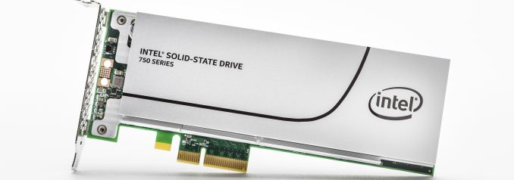
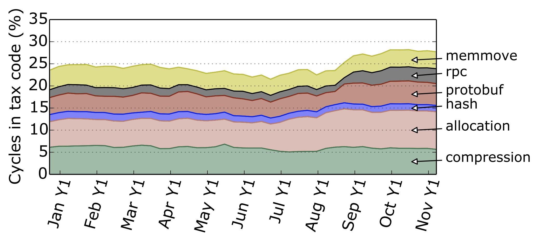
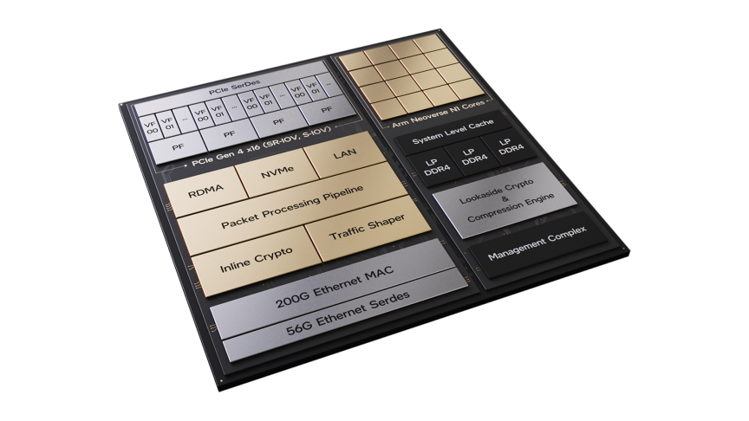
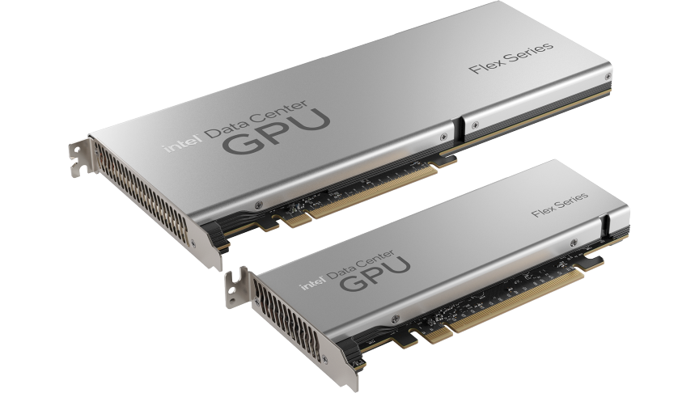
“Datacenter Tax” and “Killer Microsecond”
The impact of Datacenter tax is large
A new breed of microsecond events
Solid-State Drive
Datacenter networking
GPU/accelerators
22-27% of WSC cycles are spent in different components of “datacenter tax”.
Efficient handling of microsecond-scale events is becoming paramount for a new breed of low-latency I/O devices
Profiling a warehouse-scale computer, ISCA’15
Attack of the killer microseconds, Communications of the ACM, 2017
Notes:
To be more specific, two problems related to this have been summarized.
The first one is the datacenter tax problem, meaning the CPU cycles spent on fundamental datacenter infra can be expensive, as high as 27% of the total CPU time.
The second one is the killer microseconds, referring to the inefficiency of CPU when handling the us-level events with the emerging high-speed peripheral devices, such as SSD and NIC.
Both problems call for acceleration or offloading solutions that free the CPU from doing more critical tasks.

Slide 4

Current Efforts for Accelerating Distributed Applications
Expensive PCIe communication due to limited memory capacity!
Multiple network round-trips!
Server CPU can be overloaded!
One-sided/mixed RDMA
Two-sided RDMA/kernel-bypass with multi-core
(Smart)NIC ofﬂoading
Notes:
There have been lots of efforts to tackled the problems for distributed applications.
First, a line of research tries to reduce the networking processing cost by offloading it to user-space or RDMA hardware.
But still, as the server needs to process the application request from more and more clients, its CPU cores can be overloaded anyway.
Second, some works propose to move the request processing to clients, and the raw data is retrieved from the server by one-sided RDMA operations like READ and WRITE.
However, to deal with complex data structures and requests, multiple network round-trips are necessary to gather all required information, creating another hot-spot.
Hence, there are research further propose to leverage SmartNIC’s FPGA or ARM core to avoid such round-trips.
However, we found that due to the limited memory capacity, SmartNIC needs to frequently communicate with the host memory sub-system via PCIe link, which is quite expensive.
All these efforts motivates us to consider the right paradigm of accelerating distributed application with high performance and flexibility.

Slide 5

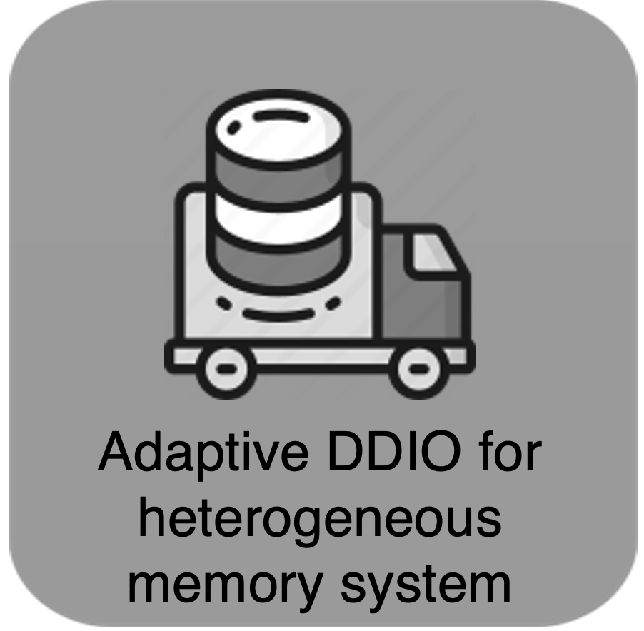




RAMBDA: A Network-architecture Co-design with RDMA and cc-accelerator
Cache-coherent accelerator (e.g., CXL):
Shared coherent memory space with CPU
More flexible interaction with CPU/memory with lower overhead
Modularized design – lower TCO
Fast RDMA-based Inter-machine Communications
Coherence-assisted Accelerator Notiﬁcation
Cache-coherent Accelerator Architecture
Adaptive DDIO for heterogeneous memory system
Notes:
In this work, we present RAMBDA, a network-architecture co-design for distributed application acceleration.
Specifically, it leverages both RDMA and the emerging cache-coherent accelerator (or cc-accelerator) technology, making the most out of each system components.
Cc-accelerator is accelerator connected to the CPU via cc-interconnect, sharing the same coherent memory domain and proving better accelerator-CPU interaction efficiency.
Unlike solutions that integrating everything on the same chip, cc-accelerator offers better flexibility and lower TCO.
LAMBDA has 4 design aspects: fast RDMA-based inter-machine communication to reduce the networking stack processing overhead,
A coherence-assisted notification mechanism to quickly invoke the accelerator with low overhead and minimal CPU cycle consumption.
A cc-accelerator architecture and can be applied to a wide range of distributed applications
And an adaptive DDIO mechanism to optimized both DRAM and novel persistent memory performance in such an I/O-intensive system.
Due to the time limit, I will discuss the first three in this talk.

Slide 6
Fast Inter-machine Communications
Snapshot of client-1 and server-A
Update response buffer’s head in client side
Update request buffer’s tail in server side
Only issue a request when the request buffer’s tail is behind the response buffer’s head.
Same mechanism is applied for intra-machine (CPU-accelerator) communication via “load/store” semantics.
Notes:
We first describe the inter-machine communication.
We employ a credit-based flow-control-like mechanism. For each client-sever pair, there will be a request-response buffer pair on both side, each of which is a ring buffer to track the status of ongoing and finsihed request.
To send an application request, the client’s CPU issue a one-sided RDMA write to the server’s corresponding request buffer’s tail entry.
For response, it’s a bit different – the cc-accelerator will directly interact with the RNIC to issue an RDMA write to update the response buffer’s head entry in the client side.
To make sure there is available entry for new request processing, we only issue a request when request buffer’s tail is behind the response buffer’s head.
Also note that, this communication mechanism is also applied to our CPU-accelerator communication via load/store, thanks to the cache-coherence feature.

Slide 7
Coherence-assisted Accelerator Notiﬁcation
Coherence signal is an efficient way for accelerator notification!
Interrupt? Slow!
Polling? Expensive and costly!
Notes:
Since one-sided RDMA is applied for inter-machine communication, the accelerator has to be notified of the new request arrival.
In general, this can be done by interrupt or spin-polling.
However, traditional interrupt will involve much hardware and OS-wise overhead,
While sping-polling may incur much traffic on the cache-coherent interconnect and have high energy cost.
We find that, the underlying hardware coherence signal can be leveraged for this purpose, as it’s exposed from the CPU chip to the cc-accelerator devices.

Slide 8
cpoll Mechanism
Notes:
Here we introduce a coherence-assisted notification mechanism call cpoll.
Conceptually, cpoll is similar to the “mwait” instruction in x86 architecture.
The first step for the cc-accelerator is to register a memory address range as the cpoll monitor region in the coherent memory space.
Then, when the RNIC conducts the write operation to a certain entry in this region, a coherence signal will be generated to reflect the coherence status change of the corresponding cache line.
This signal is used to trigger the cc-accelerator and inform the memory address.

Slide 9
cpoll Implementation
Approach 1
Captured!
Notes:
We propose two approaches to implement cpoll mechanism.
First, the request buffer or say the cpoll region can be physically allocated in the accelerator-attached memory.
So whenever the RNIC needs to update the content, it has to go through the cc-interconnect and the coherence controller on the cc-accelerator.
Thus, it will be captured by the coherence controller for sure.

Slide 10
cpoll Implementation
Approach 2
Pinned in cache
Captured!
Approach 1: better scalability, unavailable on current platform
Approach 2: feasible on the current platform, limited scalability
Notes:
For the second approach, the buffer can be allocated in the CPU-attached memory, and pinned in the local cache of the cc-accelerator.
Hence, upon the update in the CPU-attached memory, a coherence signal is passed through the cc-interconnect to invalidate the stale data in cc-accelerator’s cache.
Again, this is guaranteed to be captured by the coherence controller and thus notified to the processing logic.
The first approach has better scalability, but is infeasible on our current platform, as it doesn’t have accelerator-attached memory
The second approach, though feasible, has worse scalability -- due to the limited cache size, not too many buffers can be pinned and monitored.

Slide 11
RAMBDA cc-accelerator Architecture
RDMA SQ handler is responsible for assembling the response information.
The application processing unit receives cpoll signals and process requests.
Ring tracker tracks the previous tail of the request buffer
The scheduler fetches cpoll signals of different request buffers
coherence controller handles all the coherence trafﬁc to/from the cc-accelerator
Notes:
Here comes the cc-accelerator’s architecture. Let me use an example to walk you through the functional blocks.
As a new request’s cpoll signal comes in, it first arrives the coherence controller, which maintains the cache coherence across different regions.
The cpoll signals from different request queues will be fetched by the scheduler to enforce any QoS policy.
Since the coherence signal of a single cacheline can be coalesced, we need to track how many new requests have arrived since the last round of processing, this is done by the ring tracker.
Th application processing unit is the only application-specific block, and process the application requests and load/store data to/from the memory space.
When the request is completed, the response is assembled to the pre-defined RDMA-compatible format, and the RDMA SQ handler is responsible for issuing the RDMA command to the NIC.

Slide 12
More in the Paper
Scalability for inter-machine communication and its mitigation
Mitigation of cpoll’s Scalability limitation
Adaptive DDIO optimization for DRAM-NVM heterogenous memory system to reduce memory bandwidth utilization.
….
Notes:
There are also other aspects of our design. Please check our paper for more details.

Slide 13
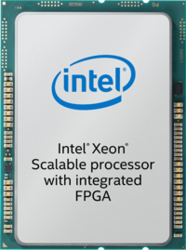
Implementation
Intel Xeon 6138P CPU@2.0GHz
20 Skylake cores, hyperthreading enabled, running Ubuntu 18
27.5MB shared LLC
Six DDR4-2666 channels, 192GB DRAM in total
In-package Intel Arria 10GX FPGA@400MHz
One UPI link to the CPU, 10.4GT/s (20.8GB/s)
64KB local cache
LUT usage: 11K (26%)
Registers usage: 130K (8%)
BRAM blocks usage: 387 (14%)
25Gbps ConnectX-6 Dx controller (RoCEv2)
Also use the Eight ARM cores on the BlueField-2 SoC and 16GB on-board DRAM as baseline for comparison.
Notes:
We implement RAMBDA in a real system.
We use the in-package FPGA of an Intel Xeon CPU as the cc-accelerator. It’s connected to the CPU via one UPI link
We also use a state-of-the-art Nvidia BlueField-2 SmartNIC as a baseline. It’s equipped with 8 high-frequency ARM cores.

Slide 14
Experiments
Three Benchmarks
In-Memory Key-Value Store
Distributed Transaction with Chain Replication
Recommender System Inference
We also use a Xilinx U280 FPGA card to emulate a cc-accelerator with local coherent memory.
U280 DDR4-based results as “RAMBDA-LD (local DDR4)”
HBM2-based results as “RAMBDA-LH (local HBM2)”
Notes:
We use three popular distributed application to demonstrate RAMBDA’s benefits and drawbacks.
Finally, given the limitation of the current hardware, we also use a Xilinx U280 FPGA to emulate the cc-accelerator with memory directly attached – this soon be generally available with the release of CXL-enabled CPUs and devices.

Slide 15
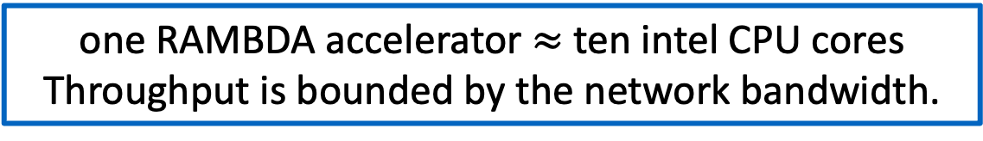
Experiment – In-Memory Key-Value Store
We compare RAMBDA with two state-of-the-art baselines: open-source two-sided RDMA-RPC (MICA-backed) (noted as “CPU”) and Smart NIC. 1M K-V pairs are pre-loaded.
one RAMBDA accelerator $≈$ ten intel CPU cores
Throughput is bounded by the network bandwidth.
RAMBDA’s average latency is a bit higher than CPU.
This deﬁciency is overcome with RAMBDA-LD/LH’s accelerator-attached memory.
Notes:
First, let’s talk about the in-memory KVS.
We compare RAMBDA with two baselines: two-sided RDMA and SmartNIC.
Regarding the throughput, we found that in both request distributions, smartNIC performs poorly. This is mainly due to its frequent memory access to the host memory, even some hot data has been cached in the smartNIC in zipfian distribution.
At the same time, the CPU solution roughly as the same performance as RAMBDA, which are both bound by network bandwidth. Note that it takes around 10 CPU cores to achieve this. We do anticipate that RAMBDA has better energy efficiency and as greater potential as the network bandwidth keeps increasing.
For latency, although similar regarding average latency, the smartNIC solution has a worse result in tail latency, which is again attributed to the host memory access via PCIe.
Also, the emulated RAMDA-LD and LH solution have a slightly better latency than the current RAMBDA, as they don’t need to go through the cc-interconnect for memory access.

Slide 16
Experiment – In-Memory Key-Value Store
We also investigate the impact of the request batch size. (100% GET workload, Zipﬁan 0.9 distribution)
Like CPU and Smart NIC, RAMBDA’s throughput also beneﬁts from batching.
RAMBDA’s latency sub-linearly increase with the batch size.
Notes:
We also investigate the impact of batch size.
Although benefiting from batching, RAMBDA is not as sensitive to batch size as CPU, as CPU solution has software optimizations like pipelining and memory access batching that rely on request batching.
Also, compared to the CPU solution, RAMBDA’s latency performance is less impacted by batch size as well, which is sub-linear.

Slide 17
Experiment – Distributed Transaction with Chain Replication
HyperLoop [1] leverages the RNIC and NVM to achieve low-latency chain replication with little CPU involvement.
We emulated two replica machines and compare RAMBDA with HyperLoop. We have different key-value pair size and (read,write) transactions.
For transactions with multiple operations, RAMBDA shows its advantage – completing everything in a single network round-trip.
[1]: Hyperloop: group-based NIC-offloading to accelerate replicated transactions in multi-tenant storage systems, SIGCOMM’18
Notes:
For the chain replication for distributed transaction, we use the the state-of-the-art HyperLoop as the baseline. It automatically invoke the RDMA NICs in the chain to write data into the NVM, avoiding CPU overhead.
However, we find that, for transactions involving multiple read/write operations, HyperLoop underperforms compared to RAMBDA, as it can only issue one read or write operation to the entire chain each time. This is the flexibility limitation.
On the other hand, thanks to the flexible cc-accelerator, RAMBDA is able to complete everything in a near-data fashion in one network round-trip over the chain.

Slide 18
Experiment – Recommender System Inference
MERCI [1] is a memoization algorithm on commodity hardware for DLRM inference – it reduces the memory bandwidth pressure of inference by memorization table lookup.
We compare RAMBDA’s performance with MERCI on the popular Amazon Review dataset.
Bound by cc-interconnect bandwidth
With local coherent memory, RAMBDA-LD/LH can show good performance.
[1]: MERCI: efficient embedding reduction on commodity hardware via sub-query memorization, ASPLOS’21
Notes:
We finally show the results of recommender system processing.
Specifically, we use MERCI, a DLRM system with memoization optimization over the amazon datasets.
In fact, we observe a significant performance drop when using RAMBDA. After further analysis, we find that this is mainly due to the high memory throughput demand of the recommender system, which saturates the cc-interconnect bandwidth.
This can be solved by the envisioned cc-accelerator with local memory attached. For example, with HBM2, RAMBDA-LH can outperform 8 CPU cores by ~3 times, with better energy efficiency.

Slide 19
Conclusion
We present RAMBDA, a holistic system design to accelerate modern microsecond-scale memory-intensive distributed applications.
RAMBDA leverages the RDMA and cc-accelerator technologies to achieve high throughput and low latency performance without the CPU’s involvement on the critical datapath.
Our evaluation on a real system shows that, compared to the CPU-based software solutions and the (Smart) NIC ofﬂoading solutions, RAMBDA is able to achieve better and more stable performance with higher power efﬁciency.

Slide 20

Questions? Contact yifan.yuan@intel.com

Slide 21
cpoll Implementation
Mitigating approach 2’s scalability limitation
Notes:
To mitigate this problem, we propose a secondary buffer.
In addition to the request buffers, we have a point buffer, each entry representing a request buffer.
The entry content is the latest position of the corresponding request buffer.
So, we only need to register the pointer buffer as the cpoll region and pin it into the cache.

Slide 22
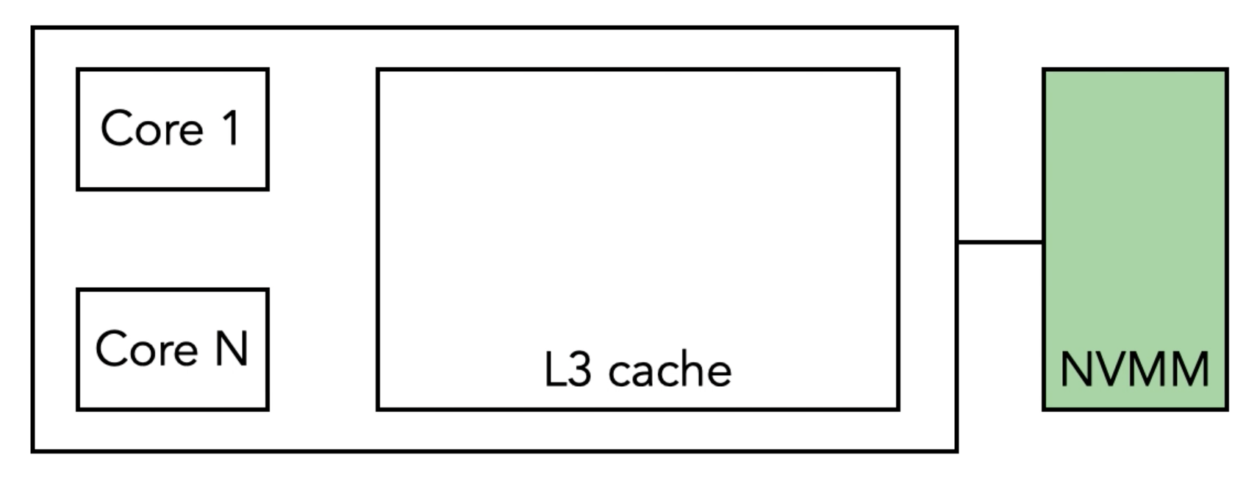


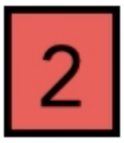
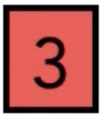



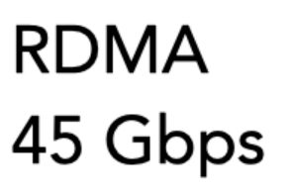
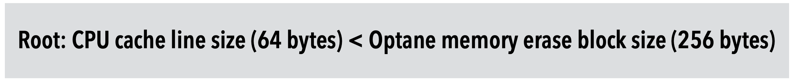
Optimizing NIC-host Data Transfer: Adaptive DDIO
DDIO is system-wide feature, how to control in with finer granularity?
Challenges and Solutions for Fast Remote Persistent Memory Access, SoCC’20

Slide 23
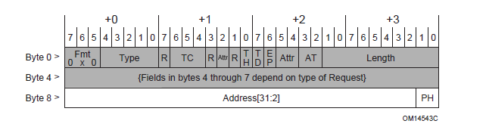
Optimizing NIC-host Data Transfer: Adaptive DDIO
We find that a rarely-discussed bit in PCIe header (TPH) can help achieve equivalent behavior.

Slide 24
Optimizing NIC-host Data Transfer: Adaptive DDIO

Slide 25
Discussion and Future Directions
Workload scheduling: dedicated scheduler + dumb NIC
Adaptive and dynamic workload dispatching: smoothen traffic fluctuation for better QoS (tail latency) performance
Multi-device collaboration for end-to-end task execution in a flexible pipeline/DAG (directed acyclic graph) manner
Notes:
animation

